Slide 1
Co-Simulation between detailed building energy performance simulation and Modelica HVAC component models
Andreas Nicolai and Anne Paepcke
andreas.nicolai@tu-dresden.de

Slide 2

Starting point: NANDRAD - Building energy simulation engine
Multi-zone building model
Realistic building physics (spatially resolved walls/storage members)
CVODE time integration engine (error controlled variable-order, variable step method)
Algebraic relations embedded in ODE equations
Using Newton-Krylov-method for non-linear system of equations
Special problem-specific sparse matrix structures and preconditioners

Slide 3
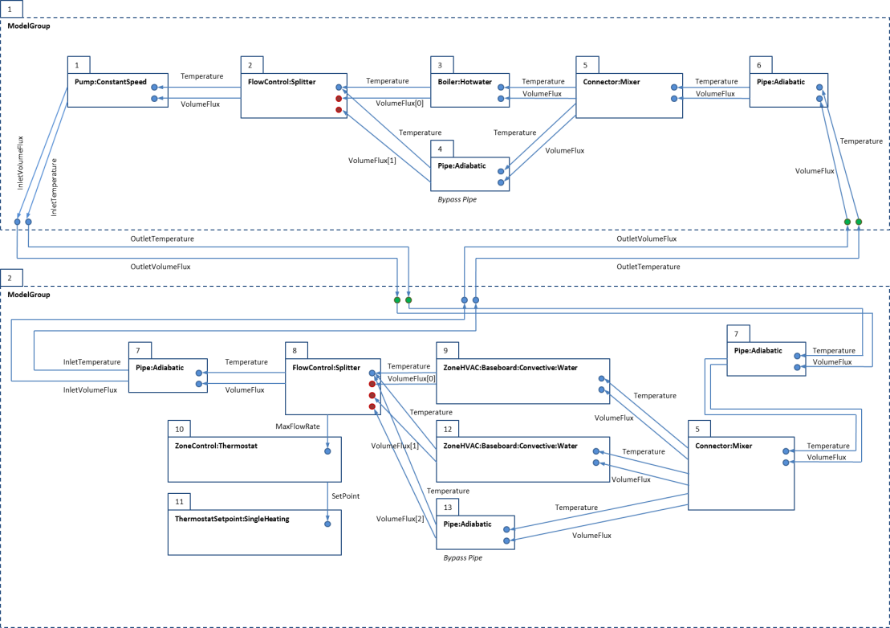
Multi-zone model, embedded equipment loop and sparsity pattern
Instead of hard-coded equipment models rather use
Modelica-based equipment models
Jacobian Matrix Sparsity Pattern

Slide 4
Idea tested: get everything into Modelica via Code-generator
A lot of code like
this!
Symbolic analysis
(OpenModelica/
SimulationX)
really slow on large
Models

Slide 5
Idea tested: get everything into Modelica via Code-generator
Alternative:
Export building as Functional Mockup Unit (FMU) and connect to Modelica equipment model
A lot of code like
this!
Symbolic analysis
(OpenModelica/
SimulationX)
really slow on large
Models

Slide 6
Software architecture of NANDRAD engine
Integrator Implementation
setTime(t)
Physical Model Implementation
solves ODE system of type ydot = f(t,y)
implicit solver with Newton-Raphson iteration
setY(y)
implements physical model equations and the computation of the system function f(t,y)
state of object changes only through calls of
control functions
ydot()
control functions
query functions
init(model)
n()
y0()
t0()
yOut(t_out)
tEnd()
stepCompleted(t,y)
step()
writeOutputs(...)
t()
Solver Control System
Implements core integration loop: calls step() function in Integrator, also manages output schedules

Slide 7
Export ODE system function via FMU for ModelExchange
Corresponds to FMI ModelInterface
Integrator Implementation
setTime(t)
Physical Model Implementation
solves ODE system of type ydot = f(t,y)
implicit solver with Newton-Raphson iteration
setY(y)
implements physical model equations and the computation of the system function f(t,y)
state of object changes only through calls of
control functions
ydot()
control functions
query functions
init(model)
n()
y0()
t0()
yOut(t_out)
tEnd()
stepCompleted(t,y)
step()
writeOutputs(...)
t()
Solver Control System
Implements core integration loop: calls step() function in Integrator, also manages output schedules

Slide 8
Export physical model and integrator as FMI for Co-Simulation
Corresponds to FMI Co-Simulation interface
Integrator Implementation
setTime(t)
Physical Model Implementation
solves ODE system of type ydot = f(t,y)
implicit solver with Newton-Raphson iteration
setY(y)
implements physical model equations and the computation of the system function f(t,y)
state of object changes only through calls of
control functions
ydot()
control functions
query functions
init(model)
n()
y0()
t0()
yOut(t_out)
tEnd()
stepCompleted(t,y)
step()
writeOutputs(...)
t()
Solver Control System
Implements core integration loop: calls step() function in Integrator, also manages output schedules
To be replaced by Co-Simulation Master

Slide 9
FMU Generation Process
Starting with BIM → Project file for standalone building simulation
Indicate which thermal zones shall be heated/cooled and be used in the FMU-interface
Run design day simulations (heating/cooling)
Generate report file (zone ID – variable index mapping, design loads)
Create ModelDescription.xml
Create Modelica-Wrapper and Adapter models (corresponding to project)
Compress project file, all database files, pre-compiled FMU-DLL and additional dependent libraries into FMU-archive
Steps 3 to 7 are done automatically by NANDRAD solver via command line:
NandradSolver RowHouse_var1.nandrad --fmu-export=RowHouse_var1.fmu
(exported FMU is exported as FMI version 2, for both ME and CS)

Slide 10
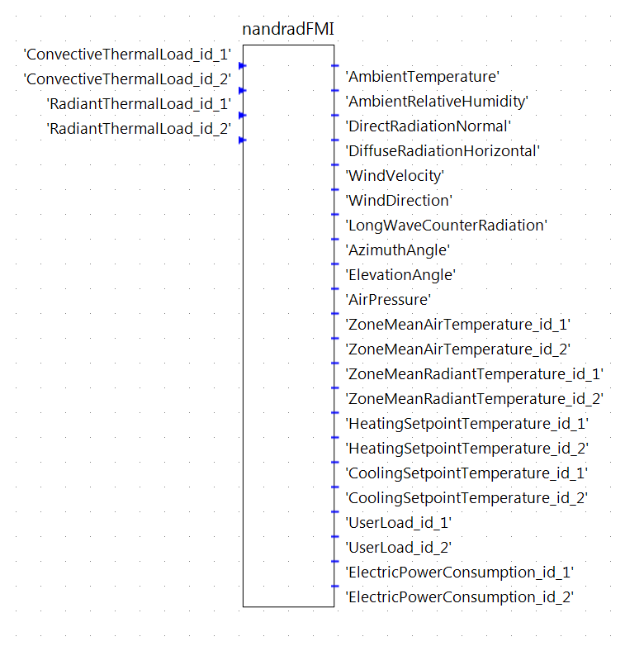
FMI Interface to NANDRAD Building Model FMU

Slide 11
FMI Interface to NANDRAD Building Model FMU
Outputs
Climate data

Slide 12
FMI Interface to NANDRAD Building Model FMU
Outputs
Climate data
Zone air/ radiant temperatures

Slide 13
FMI Interface to NANDRAD Building Model FMU
Outputs
Climate data
Zone air/ radiant temperatures
Setpoint temperatures (schedules)

Slide 14
FMI Interface to NANDRAD Building Model FMU
Outputs
Climate data
Zone air/ radiant temperatures
Setpoint temperatures
Electric loads
Warm water consumption

Slide 15
FMI Interface to NANDRAD Building Model FMU
Outputs
Climate data
Zone air/ radiant temperatures
Setpoint temperatures
Electric loads
Inputs
Convective and radiant thermal loads

Slide 16
FMI Interface to NANDRAD Building Model FMU
Outputs
Climate data
Zone air/ radiant temperatures
Setpoint temperatures
Electric loads
Inputs
Convective and radiant thermal loads
Zone specific inputs/outputs scale with
number of zones! Manual connection ???

Slide 17
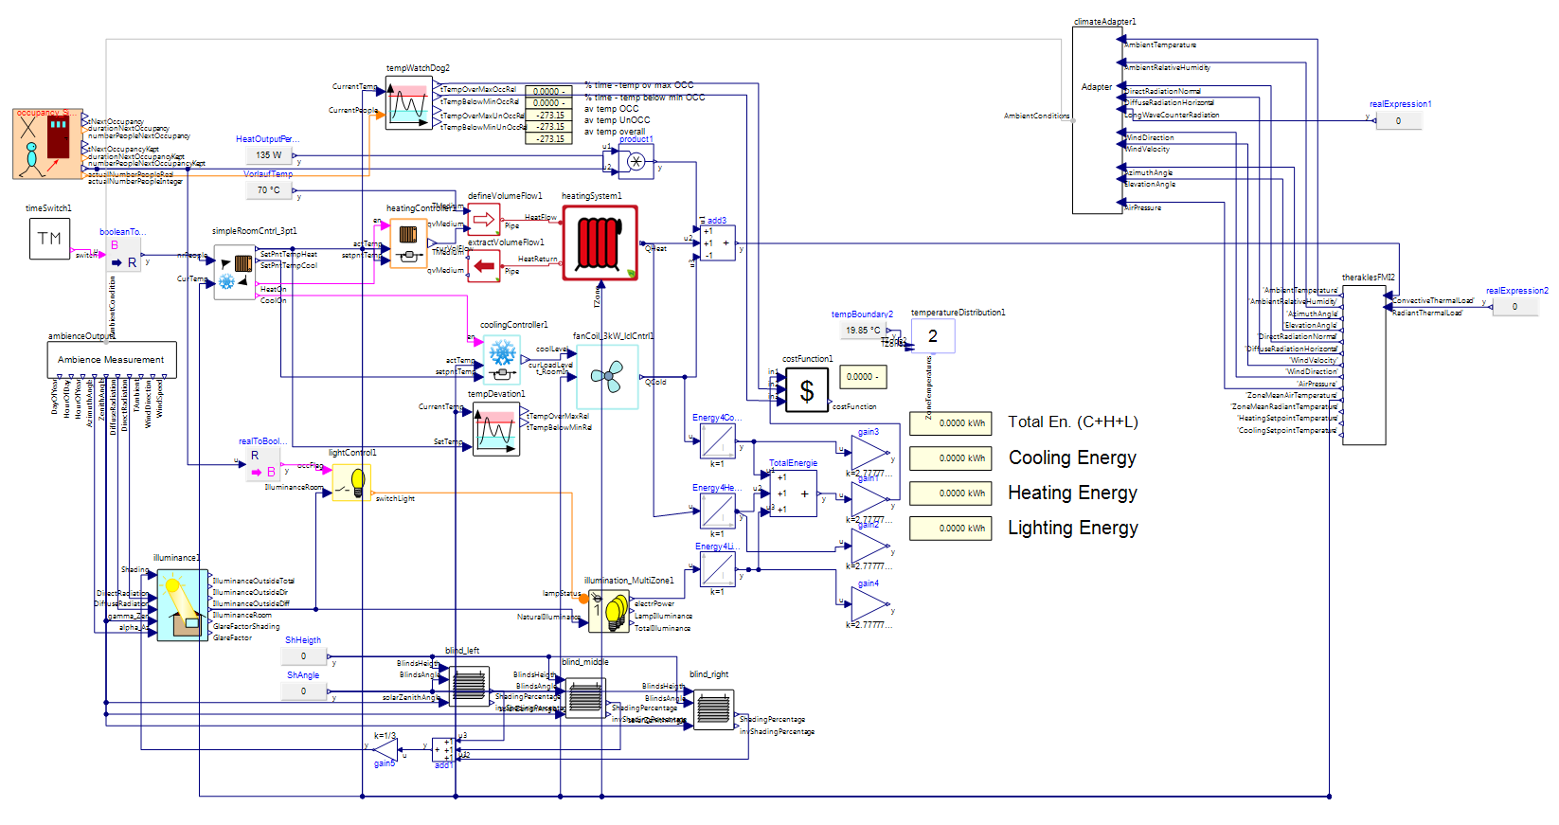
Application Scenario 1: Import into Modelica environment
Demonstration Case 1
Building FMU

Slide 18
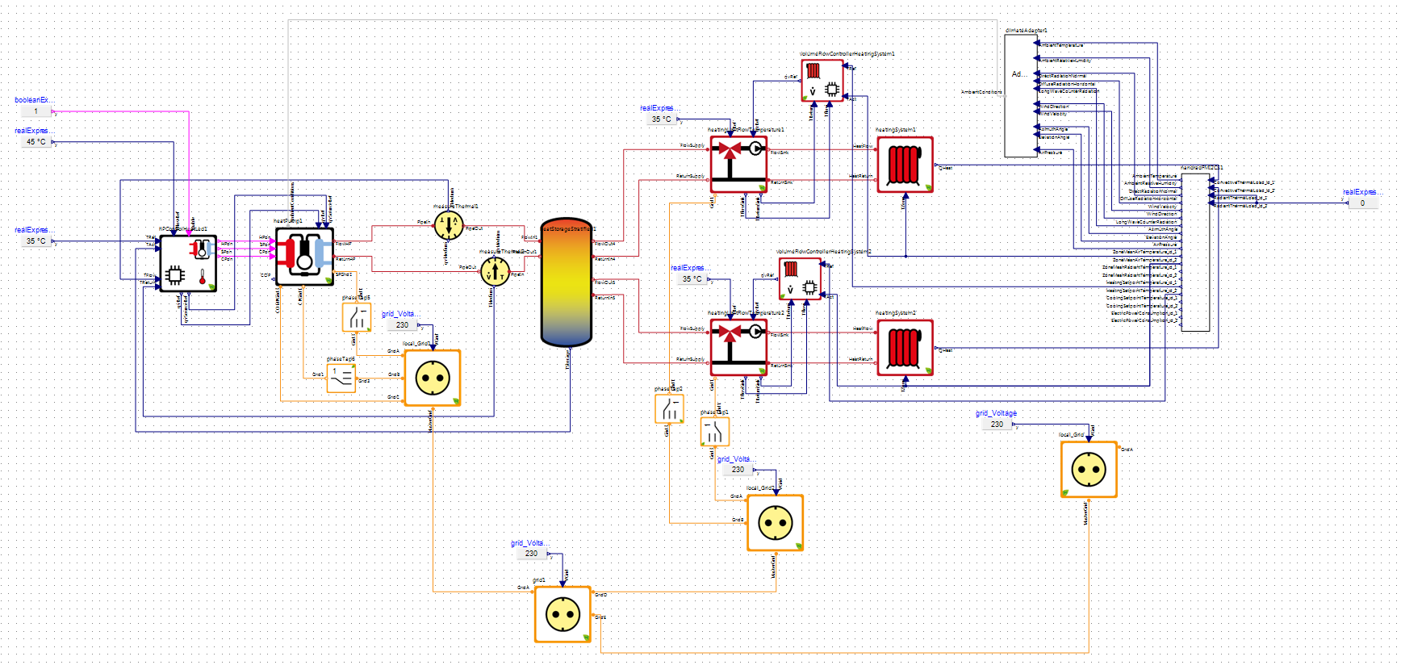
Application Scenario 1: Import into Modelica environment
Demonstration Case 2
Building FMU

Slide 19
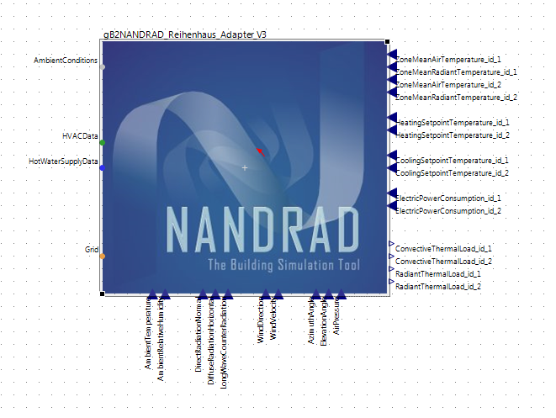
Introduce Modelica-Adapter Models (autogenerated)

Slide 20
Introduce Modelica-Adapter Models (autogenerated)
Connectors match complex ports of HVAC library
Connectors match exactly native FMU
connectors by name

Slide 21
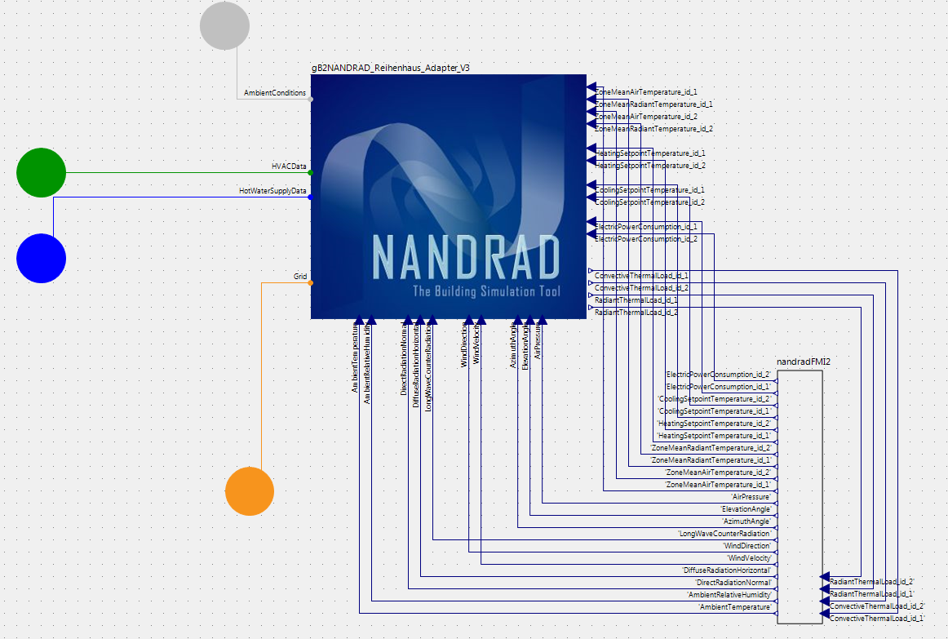
Introduce Modelica-Wrapper Models (autogenerated)
Adapter
model
Imported
FMU

Slide 22
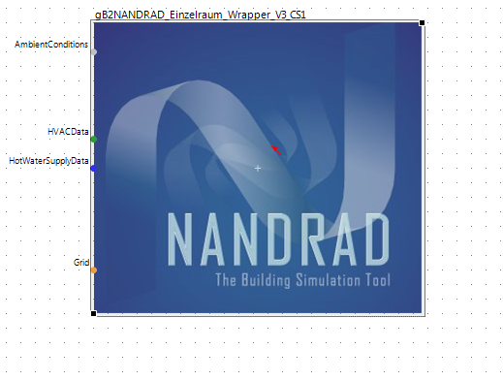
Introduce Modelica-Wrapper Models (autogenerated)
The building model from point of view of the user
within the Modelica environment

Slide 23
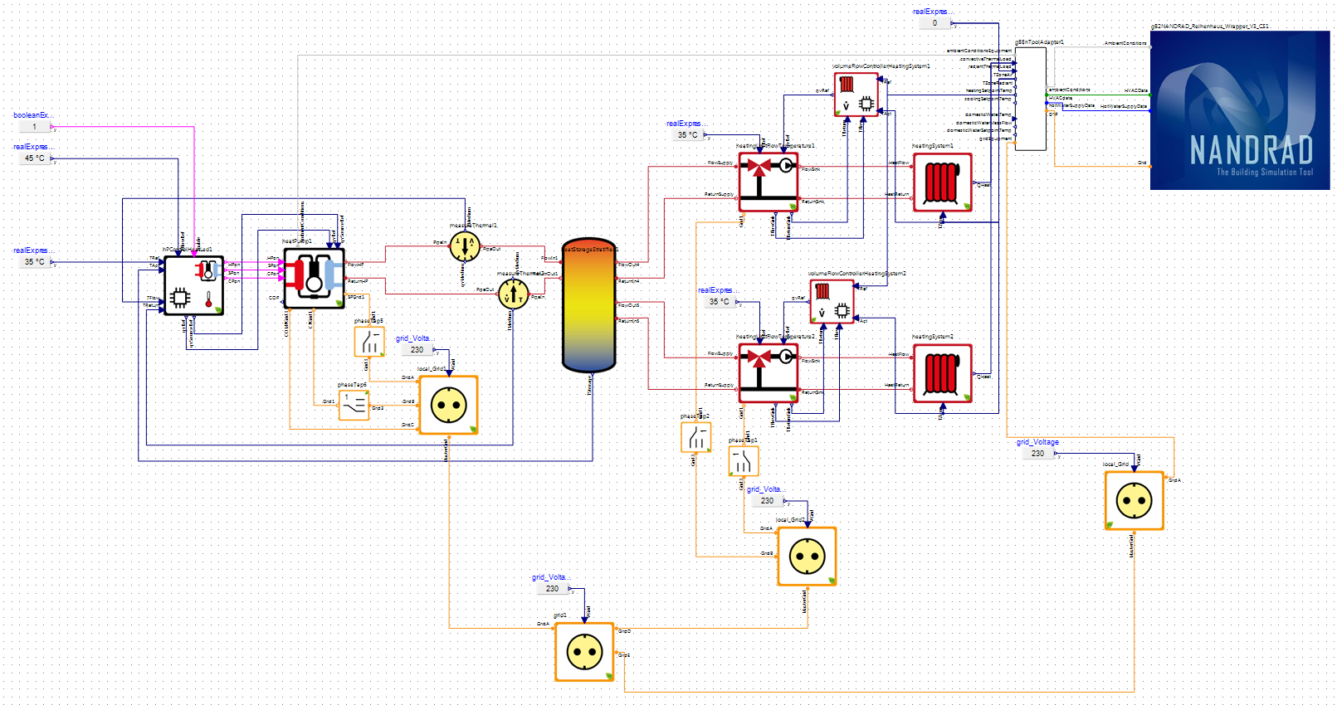
Introduce Modelica-Wrapper Models (autogenerated)
Only need to
connect a few
ports

Slide 24
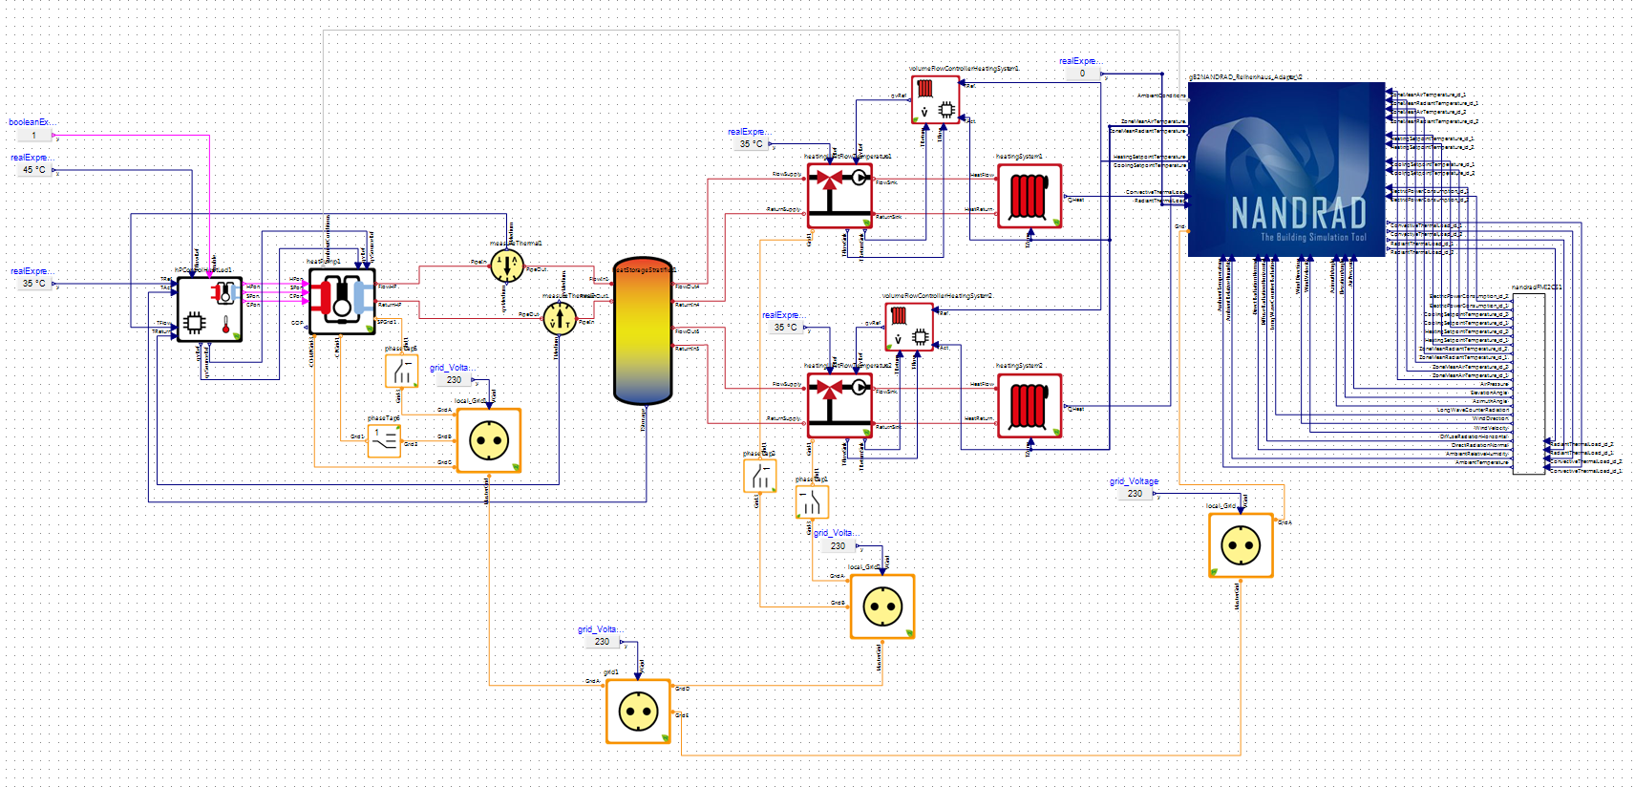
Application Scenario 2: Export equipment FMU
Export FMU – with only
adapter variables
as FMI interface variables

Slide 25
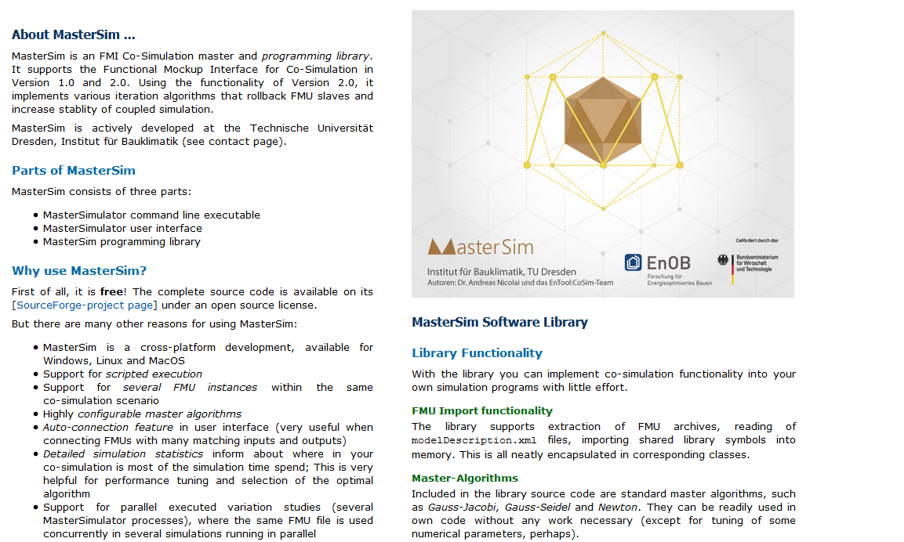
Application Scenario 2: Co-Simulation with CoSim-Master
Open-Source Co-Simulation Master developed at TU Dresden, Germany
http://mastersim.sourceforge.net

Slide 26
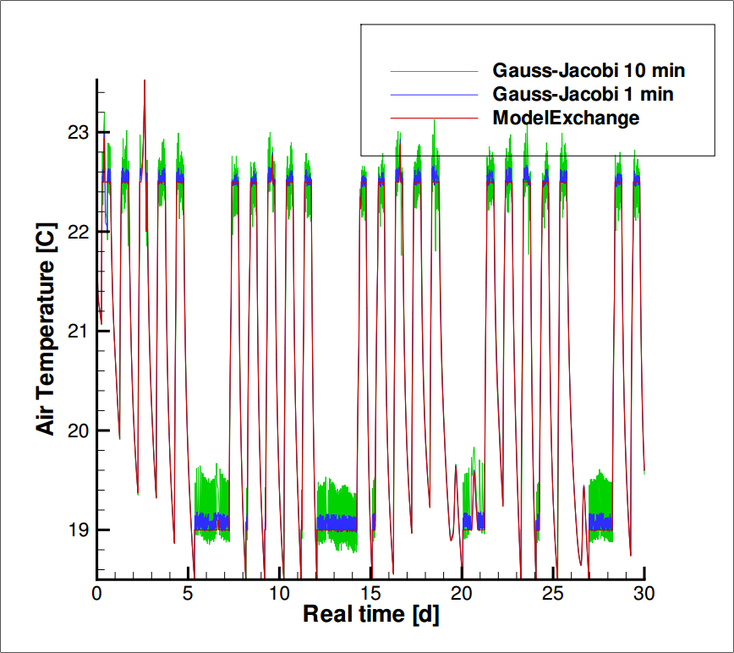
Co-Simulation: fixed-step size – stability problems

Slide 27
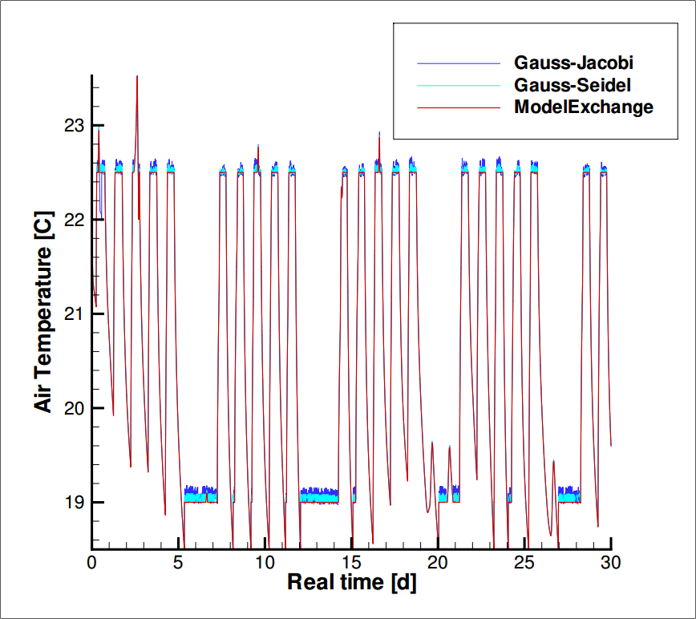
Co-Simulation: Fixed step size – Gauss-Seidel better

Slide 28
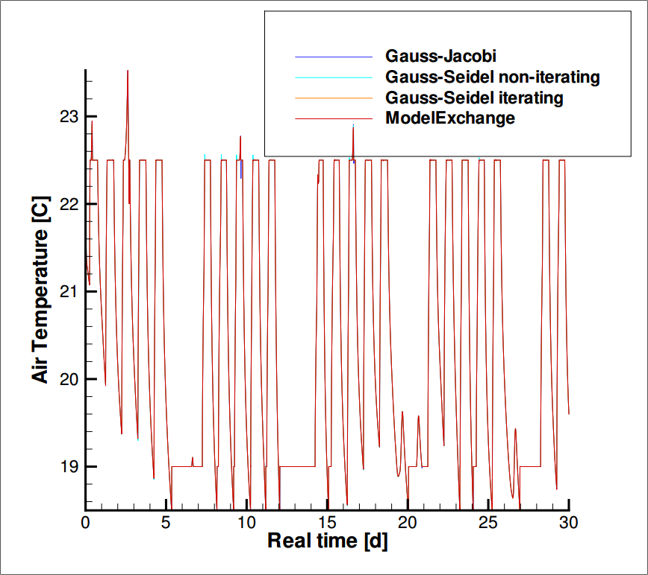
Co-Simulation: with adaptive step-size (error controlled)

Slide 29
Summary
Building energy simulation NANDRAD can now be used as FMI for ME/CS (version 2, with get/set state capability)
Use case 1 (within Modelica environment):
  NANDRAD-FMU substitutes simpler building models (when needed)
  Modelica-Wrapper-Models significantly simplifies connecting FMUs with hundreds of input/output variables
Use case 2 (Equipment FMU + Building FMU running in external Co-Simulation Master)
  Use of adapter models simplifies setup of co-simulation szenario
  Choice of master algorithm has great impact on stability/accuracy and performance

Slide 30
Co-Simulation between detailed building energy performance simulation and Modelica HVAC component models
Andreas Nicolai and Anne Paepcke
andreas.nicolai@tu-dresden.de

Slide 31
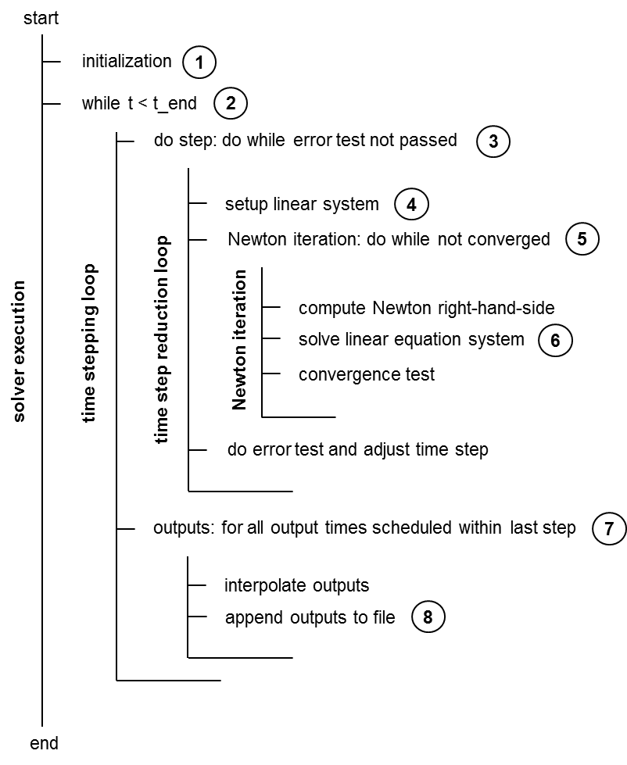
Internal functionality (only for discussion)

Slide 32
Functionality within Co-Simulation Master
Model acts as a Co-Simulation slave
Interacts with Master through get/set functions
Time integration is done within a communication step when Master calls doStep()

Slide 33
Master requests slave to integrate over
a communication interval starting from a known
solution
y
t0
t_commStart
t_commEnd
Integration
time frame
Master->doStep(...)

Slide 34
computed solutions after
completed integration step
Integrate step-by-step and adapt time step size
based on local error control
y
t0
t_commStart
t_commEnd
Integration
time frame
dt
Time steps
Master->doStep(...)

Slide 35
computed solutions after
completed integration step
Integrate until communication interval has
been completed
y
t0
t_commStart
t_commEnd
Integration
time frame
dt
Time steps
Master->doStep(...)

Slide 36
computed solutions after
completed integration step
Limit last time step to hit communication interval
end time exactly
y
t0
t_commStart
t_commEnd
Integration
time frame
dt
Time steps
Limit time step to
match interval end
Master->doStep(...)

Slide 37
computed solutions after
completed integration step
Outputs may be requested at different times
than time step or communication interval end time
y
t0
t_commStart
t_commEnd
Integration
time frame
dt
Time steps
Outputs
output_dt
Limit time step to
match interval end
Master->doStep(...)

Slide 38
computed solutions after
completed integration step
Outputs are interpolated in last completed
integration step (can be several outputs)
y
interpolated solution at output time point
t0
t_commStart
t_commEnd
Integration
time frame
dt
Time steps
Outputs
output_dt
Limit time step to
match interval end
Master->doStep(...)

Slide 39
Things to consider…
Limit last time step
When interpolating model state backwards in last step, restore model state to end of communication interval before returning control to master
… otherwise pretty straight forward …

Slide 40
Iterative Master algorithms
Gauss-Jacobi, Gauss-Seidel, Newton
Master requests Slave to store its state
Master can request Slave to store multiple states
Master requests Slave to reset its state back to a previously stored state (roll-back)
Related functions:
  fmi2Serialize(), fmi2Deserialize(), fmi2SerializedFMUstateSize(),
  fmi2GetFMUState(), fmi2SetFMUState()

Slide 41
Getting and Setting FMU State
State is defined by:
  Integrator (conservation variables of ODEs)
  LES solver (for direct solvers factorized Jacobian)
  Jacobian matrix (unfactorized)
  Preconditioner (unfactorized and in case of ILU also factorized)
  Model state (e.g. hysteresis variables)

Slide 42
Getting and Setting FMU State
Fragmented memory structures
Direct copy not meaningful (and not fast)
→ Copy into sequential memory first
Implement first serialize and deserialize functionality

Slide 43
Getting FMU State via Serialization
Typical implementation of fmi2GetFMUState():

Slide 44
Serialization into sequential memory
Fragmented memory structures
Sequential memory
"Append"-pointer

Slide 45
Serialization into Sequential Memory
Fragmented memory structures
Sequential memory
"Append"-pointer

Slide 46
Serialization into Sequential Memory
Fragmented memory structures
Sequential memory
"Append"-pointer

Slide 47
Serialization into Sequential Memory
Fragmented memory structures
Sequential memory
"Append"-pointer

Slide 48
Serialization into Sequential Memory
Fragmented memory structures
Sequential memory
"Append"-pointer

Slide 49
Serialization into Sequential Memory
Maintainable code → Single code for:
Size calculation
Copy into sequential memory
Copy back from sequential memory
For C compatibility (e.g. for CVODE integrator)
use Macros

Slide 50
Serialization into Sequential Memory

Slide 51
Serialization into Sequential Memory

Slide 52
Serialization into Sequential Memory
Single code for mapping memory depending
on selected operation type (op):

Slide 53
Aspects of creating a coupled building energy simulation
Adding FMI ME+CS interface to a stand-alone simulation engine
Implementing FMU v2 setting/getting-state capability
FMU generation process + resource handling
Application scenarios
Interface conventions
Usability (Modelica-Wrapper/Adaptors)
Demonstration cases (findings and experience gained)

